Slide 1
SORTING STATION
By
Muhamad Syafiq Adam Bin Shamsul Azuan

Slide 2
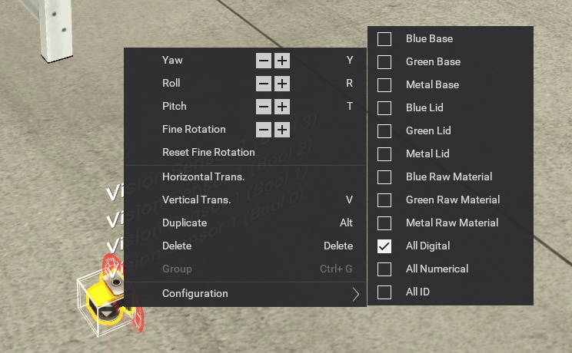
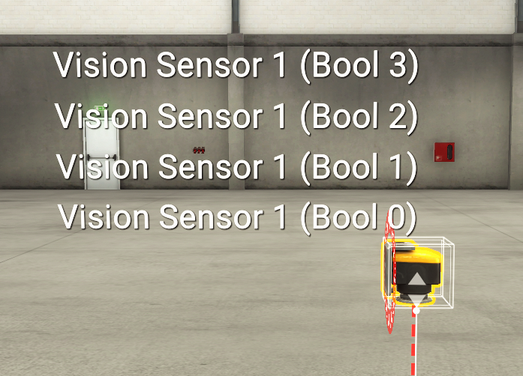
1. Introduction
Sorting Station is an automated system designed to identify, categorize, and redirect products or materials based on specific criteria like size, weight, color, or material type.
All Digital setting

Slide 3
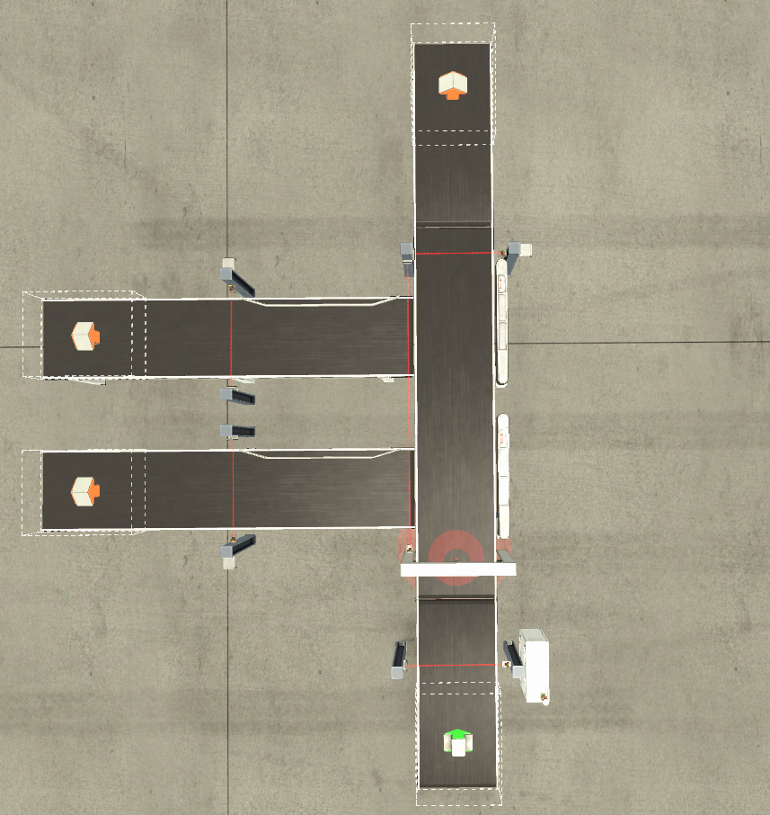
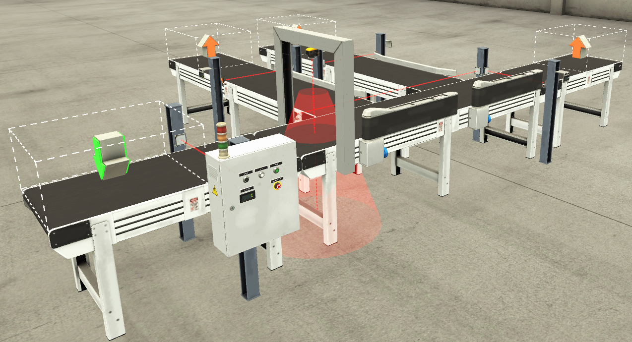
2. Designs
PLASTIC & METAL LID LINE
PLASTIC BASE LINE
METAL BASE LINE

Slide 4
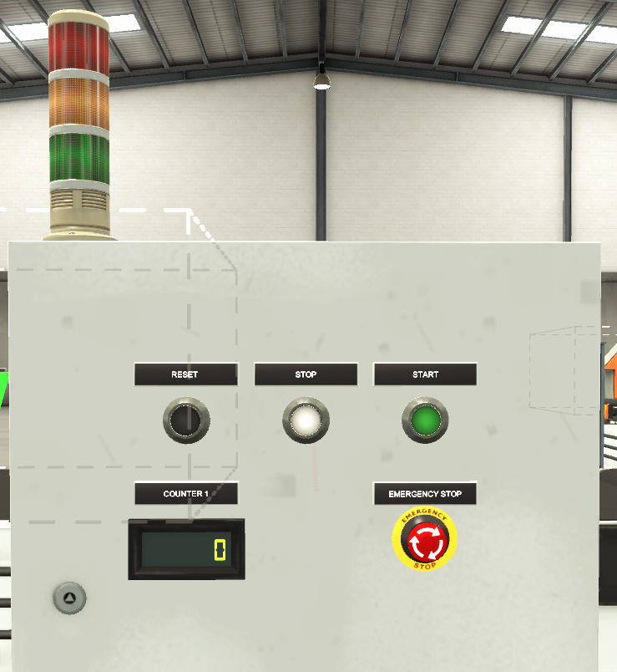
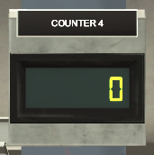
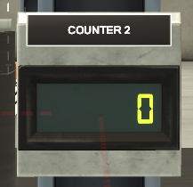
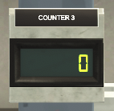
2. Designs
Main Panel

Slide 5
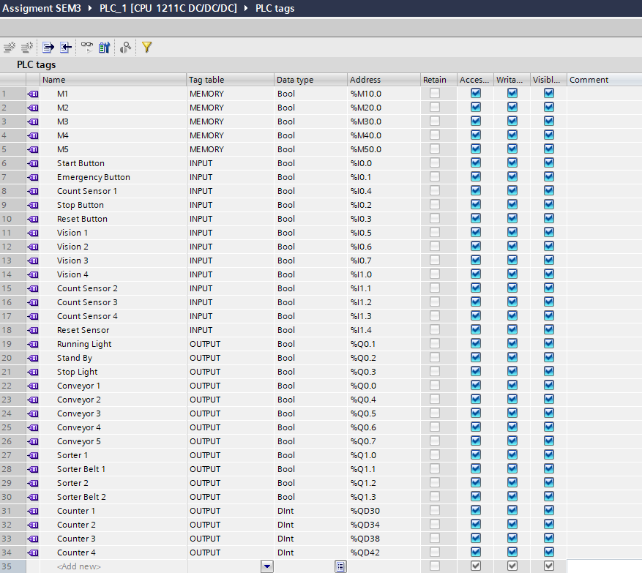
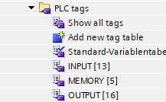
3. Programming
3.1. PLC tags

Slide 6
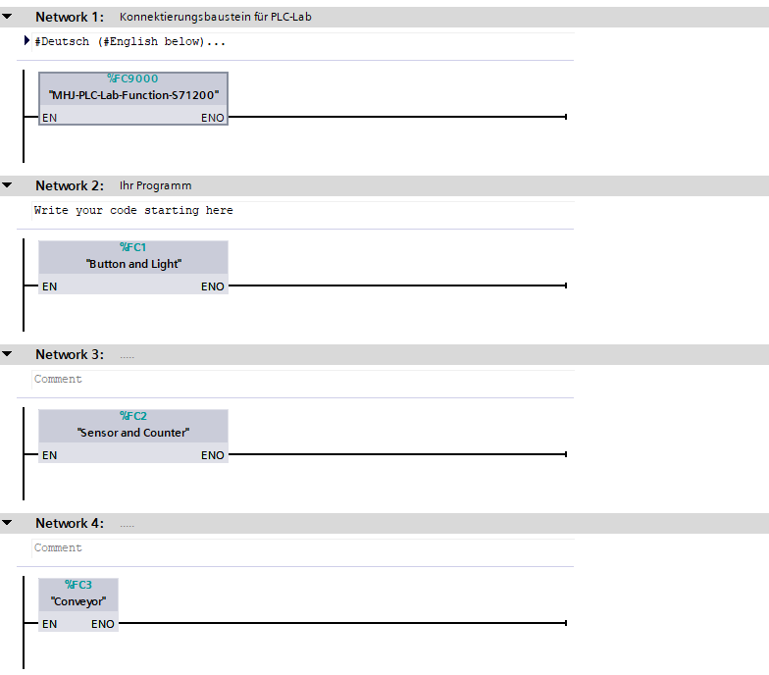
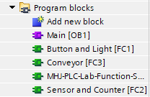
3.2. Program Blocks

Slide 7
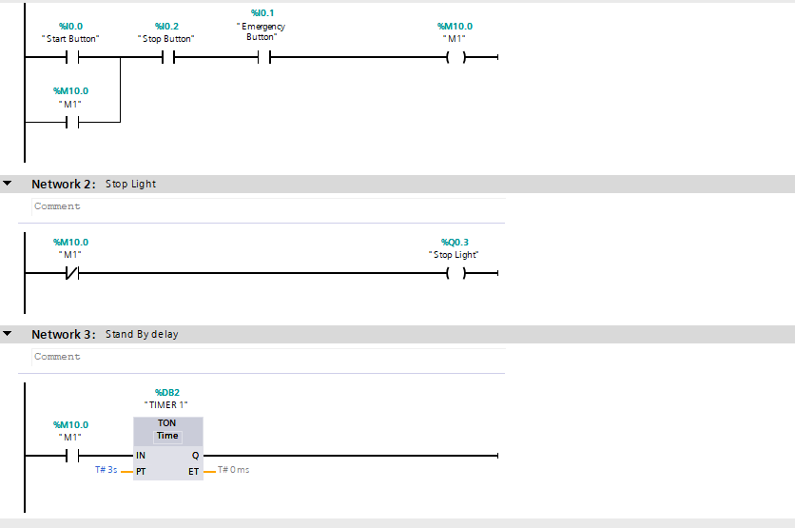
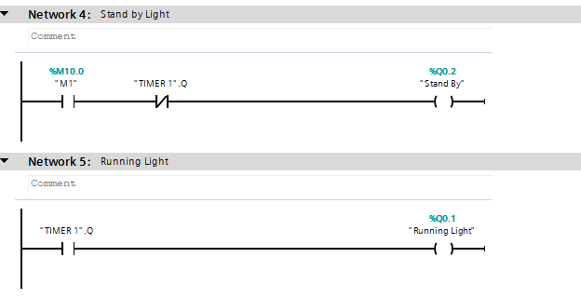
3.3. Program Blocks ( Button & Light )

Slide 8
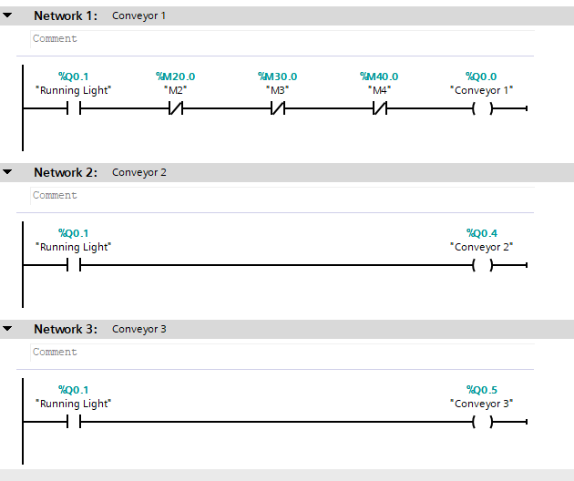
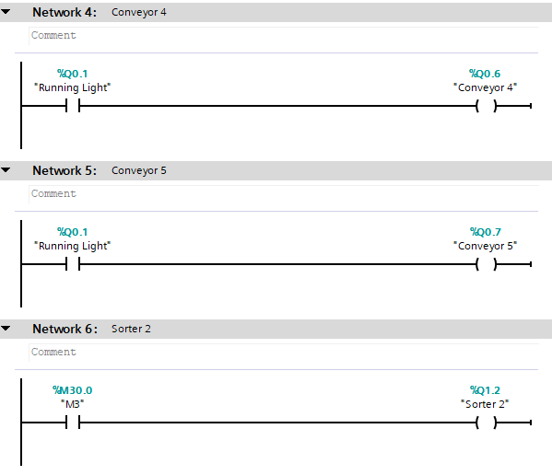
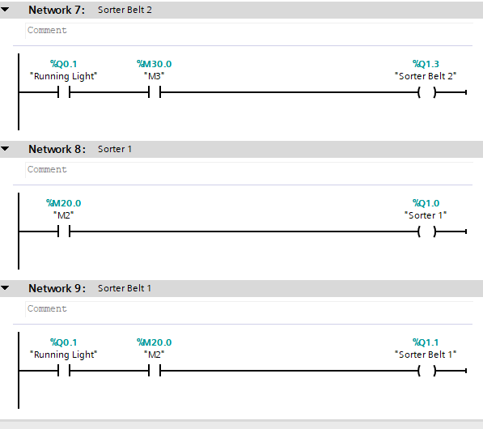
3.4. Program Blocks ( Conveyor )

Slide 9
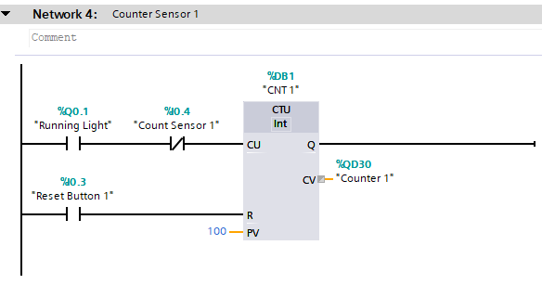
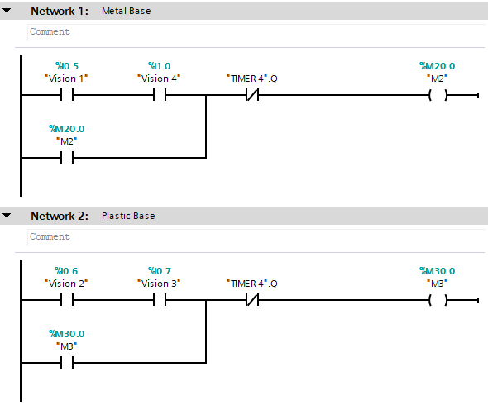
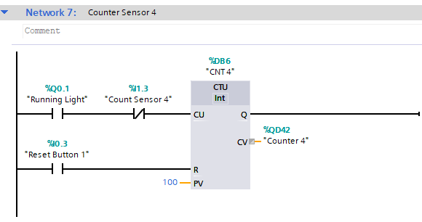
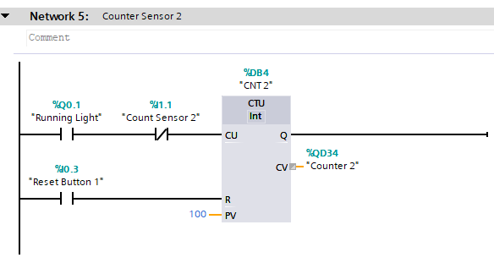
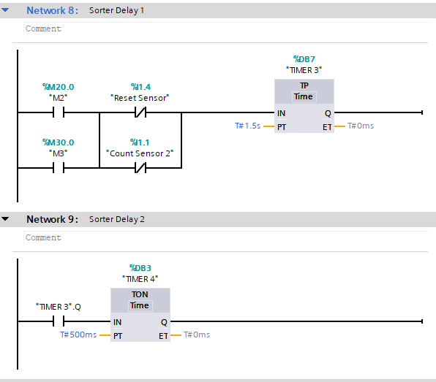
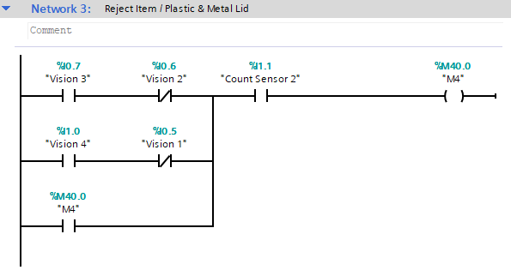

3.5. Program Blocks ( Sensor & Counter )

Slide 10
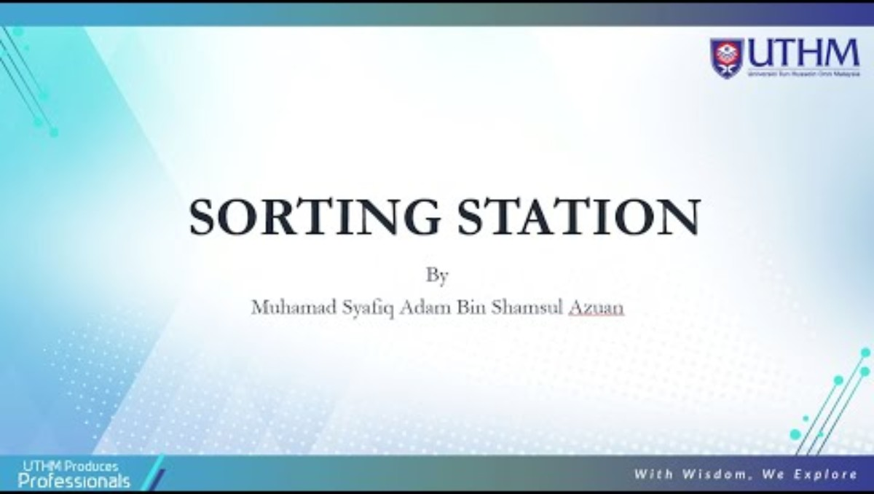
4. Simulation

Slide 11
5. Discussion
Siemens Ladder Logic (LAD):
- Mastered the use of Tags and Symbolic Addressing to create readable, industrial-grade code.
- Implemented Self-Holding (Latching) circuits to manage system states without needing permanent physical switches.
Advanced Timing Control:
- TON (On-Delay Timer): Used for the 3-second startup sequence, ensuring the system transitions safely from "Standby" to "Running".
- TP (Pulse Timer): Applied for fixed-duration events (like a pusher arm extending and retracting for a set time).
Precision Counting:
- IEC Counters (CTU): Developed logic to track the throughput of the sorting station, allowing for real-time monitoring of how many Metal vs. Plastic parts were processed.

Slide 12
6. Conclution
This project demonstrates how intelligent PLC programming can transform a simple conveyor into an efficient, data-driven sorting system ready for the modern industry.
Notes:
Dengan adanya projek ini, terbuktilah yg plc Adalah programming yg flexible dalam industry.

Slide 13
Thank You

